Slide 1
The RNR Simulation Tool & AB109 Programs
Sara Debus-Sherrill, Ph.D.
Center for Advancing Correctional Excellence
Criminology, Law and Society
George Mason University
www.gmuace.org
sdebussh@gmu.edu

Slide 2
Goals
Comprehensive survey of what types of services are being provided through AB109 funding.
Examine use of evidence-based practices and other promising approaches.
Compare available programming to needs of the population.
Determine training and technical assistance needs.

Slide 3
The RNR Simulation Tool
The RNR Simulation Tool

Slide 4
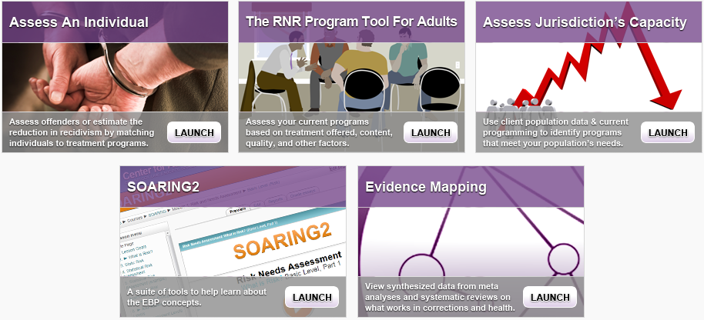
http://www.gmuace.org/tools/

Slide 5
The RNR Simulation Tool
Individual Assessment focuses on:
Identifying criminogenic needs
Matching people to type and intensity of treatment
Program Assessment focuses on:
Classifying programs to target specific needs
Rating key program features
Linking to meta-analyses/systematic reviews
Jurisdiction Assessment focuses on:
Evaluating needs of population
Comparing with existing capacity to meet needs

Slide 6
Program Assessment Domains
On-line survey of program structure and features
Uses criteria from research literature
Includes CPC+ASAM+LOCUS; behavioral health
Identifies major areas of strengths and areas for improvement

Slide 7
Program Quality and Adherence to EBPs Matter
Program quality (e.g., Implementation, Risk-Need Assessment, Orientation) related to recidivism
Lowenkamp, Latessa, & Smith, 2006; see also Nesovic, 2003

Slide 9
Jurisdiction Assessment

Slide 10
Jurisdiction Assessment

Slide 11
Jurisdiction Assessment

Slide 12
Final Notes
NOT a test, but a tool
The RNR Simulation Tool is ONE component of ACPD’s capacity enhancement efforts
Helps the county and organizations increase their use of evidence-based practices
Will help providers meet the requirements for future ACPD funding
Will guide development of the future CBO leadership academy
Will inform the development of the $500,000 evidence-based practices RFP

Slide 13
Next Steps
Sending out information to eligible organizations in January/February
Program Assessment will launch in Spring
Analyzing program responses in Summer and performing Jurisdictional Assessment in Fall
Thank you!

Slide 14
Faye S. Taxman, Ph.D.
University Professor
Center for Advancing Correctional Excellence
Criminology, Law and Society
George Mason University
4087 University Drive
Fairfax, VA 22030
James M. Byrne, Ph.D.
Professor
University of Massachusetts, Lowell
Griffith University
April Pattavina, Ph.D.
Discrete Event Model
Associate Professor
University of Massachusetts, Lowell
Avinash Singh Bhati, Ph.D.
Simulation Model
Maxarth, LLC
Amy Murphy, MPP
Jennifer Lerch, MA
Heather Toronjo, MPP
George Mason University
4087 University Drive
Fairfax, VA 22030
Special Acknowledgements:
Bureau of Justice Assistance
BJA: 2009-DG-BX-K026
Center for Substance Abuse Treatment
SAMHSA: 202171
Public Welfare Foundation
Special Thanks to:
Ed Banks, Ph.D.
Ken Robertson
Jon Berg

Slide 15
Thank you! sdebussh@gmu.edu
This project received funding from Bureau of Justice Assistance, Center for Substance Abuse Treatment, and Public Welfare Foundation. Views expressed here are ours and not the positions or policies of the funders.

